Slide 1
Binary Search Tree

Slide 2
Binary Search Trees (BST)
A data structure for efficient searching, insertion and deletion
A Binary Tree with following properties
For every node X
All the keys in its left sub-tree are smaller than the key value in X
All the keys in its right sub-tree are larger than
the key value in X

Slide 3
Are these BSTs? only the keys are shown
50
Is this a BST?
25
75
12
45
66
90
50
Is this a BST?
25
75
12
55
73
90

Slide 4
Binary Search Trees
The same set of keys may have different BSTs
Average depth of a node is O(log N)
Maximum depth of a node is O(N)

Slide 5
Searching BST
If we are searching for 15, then we are done.
If we are searching for a key < 15, then we should search in the left subtree.
If we are searching for a key > 15, then we should search in the right subtree.

Slide 7
Searching (find)
Find: return the node that has key X, or NULL if there is no such node item.
private BinaryNode find( int x, root t ) {
while( t != null ) { if( x < t.element ) t = t.left; else if( x > t.element ) t = t.right; else return t; // Match } return null; // Not found }

Slide 8
findMin/ findMax
Goal: return the node containing the smallest (largest) key in the tree
Algorithm: Start at the root and go left (right) as long as there is a left (right) child. The stopping point is the smallest (largest) element
protected BinaryNode findMin( BinaryNode t ) { if( t != null ) { while( t.left != null ) t = t.left; } return t; }
Time complexity = O(height of the tree)

Slide 9
Insertion
Proceed down the tree as you would with a find
If X is found, do nothing
Otherwise, insert X at the last spot on the path traversed
Time complexity = O(height of the tree)

Slide 10


Deletion
When we delete a node, we need to consider how we take care of the children of the deleted node.
This has to be done such that the property of the search tree is maintained.

Slide 11
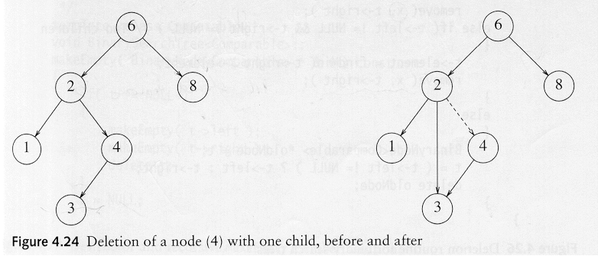
Deletion under Different Cases
Case 1: the node is a leaf
Delete it immediately
Case 2: the node has one child
Adjust a link from the parent to bypass that node

Slide 12
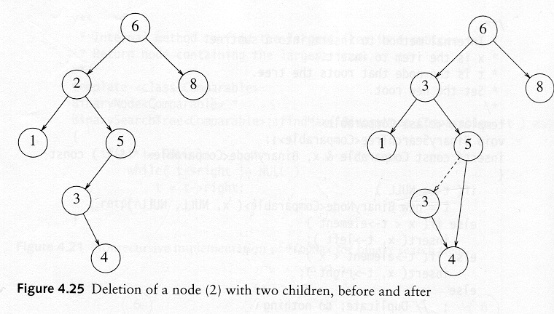
Deletion Case 3
Case 3: the node has 2 children
Replace the key of that node with the minimum element at the right sub-tree
Delete that minimum element
Has either no child or only right child because if it has a left child, that left child would be smaller and would have been chosen. So invoke case 1 or 2.
Time complexity = O(height of the tree)

Slide 13
Analysis of BST operations
The cost of each binary search tree operation (insert, find, remove) is proportional to the number of nodes accessed during the operation.
Time complexity = O(height of the tree)
Unfortunately, we have no guarantee that the tree is perfectly balanced. In the best case, we have logarithmic access cost and in the worst case we have linear access cost.
There are several, competing ways to define trees that will cause them to be balanced. E.g.: AVL tree, the b-trees, and the red-black trees.
Notes:
An AVL Tree is a binary search tree such that for every internal node v of T, the heights of the children of v can differ by at most 1.

